Slide 1

Nested Loops
Chris Piech
CS106A, Stanford University

Slide 2
Challenge: Sentinel Loops
sentinel: A value that signals the end of user input.
sentinel loop: Repeats until a sentinel value is seen.
Example: Write a program that prompts the user for numbers until the user types -1, then output the sum of the numbers.
In this case, -1 is the sentinel value.
Type a number: 10
Type a number: 20
Type a number: 30
Type a number: -1
Sum is 60
Notes:
11:45AM
Think pair share (hint: fencepost)

Slide 3
Example: Sentinel Loops
int sum = 0;
int num = readInt("Enter a number: ");
while (num != -1) {
sum = sum + num;
num = readInt("Enter a number: ");
}
println("Sum is " + sum);

Slide 4
Syntactic Sugar
// this line works
sum = sum + num;
// identically...
sum += num;

Slide 5
Syntactic Sugar
// this line works
sum = sum + 1;
// identically...
sum += 1;
// identically...
sum++;

Slide 6
Example: Sentinel Loops
int sum = 0;
int num = readInt("Enter a number: ");
while (num != -1) {
sum = sum + num;
num = readInt("Enter a number: ");
}
println("Sum is " + sum);

Slide 7
Example: Sentinel Loops
int sum = 0;
int num = readInt("Enter a number: ");
while (num != -1) {
sum += num;
num = readInt("Enter a number: ");
}
println("Sum is " + sum);

Slide 8
Syntactic Sugar
// end the loop now
break;

Slide 9
Example: Sentinel Loops
// Solution #2
// harder to see loop end condition here
int sum = 0;
while (true) {
int num = readInt("Enter a number: ");
if (num == -1) {
break; // immediately exits loop
}
sum += num;
}
println("Sum is " + sum);
Notes:
Break exits the closest loop it is in
”Loop and a half” – not as good style
You can have more complex conditions if you want…

Slide 10
Syntactic Sugar
// this line works
age = age - 1;
// identically...
age -= 1;
// identically...
age--;

Slide 11
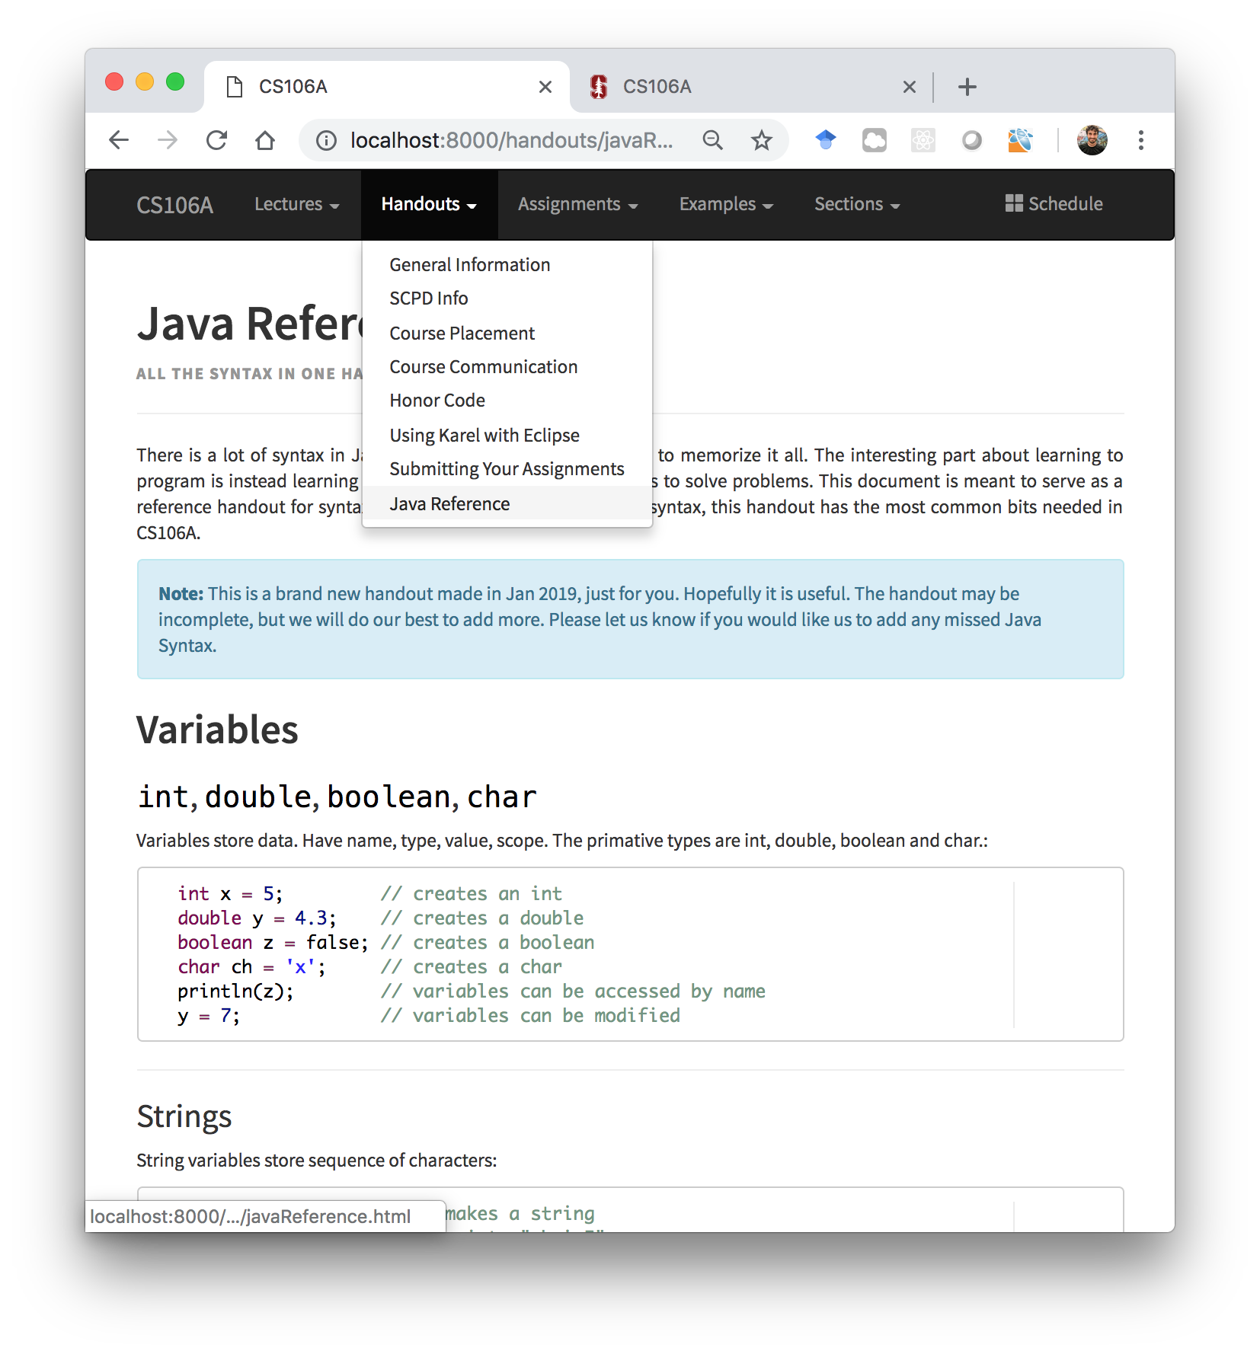
All the Syntax

Slide 12
How would you println “Stanford rocks socks”
100 times

Slide 13
For Loop Redux
public void run() {
for(int i = 0; i < 100; i++) {
println(“Stanford rocks socks!”);
}
}

Slide 14
For Loop Redux
Enters the loop if this condition passes
This line is run each time the code gets to the end of the ‘body’
This line is run once, just before the for loop starts
for(int i = 0; i < 100; i++) {
println(“Stanford rocks socks!”);
}

Slide 15

For Loop Redux
for(int i = 0; i < 3; i++) {
println(“Stanford rocks socks!”);
}
For Loop Redux

Slide 16
For Loop Redux
for(int i = 0; i < 3; i++) {
println(“Stanford rocks socks!”);
}
For Loop Redux

Slide 17
For Loop Redux
i
0
for(int i = 0; i < 3; i++) {
println(“Stanford rocks socks!”);
}
For Loop Redux

Slide 18
For Loop Redux
i
0
for(int i = 0; i < 3; i++) {
println(“Stanford rocks socks!”);
}
For Loop Redux

Slide 19
For Loop Redux
i
0
for(int i = 0; i < 3; i++) {
println(“Stanford rocks socks!”);
}
For Loop Redux
Stanford rocks socks

Slide 20
For Loop Redux
i
1
for(int i = 0; i < 3; i++) {
println(“Stanford rocks socks!”);
}
For Loop Redux
Stanford rocks socks

Slide 21
For Loop Redux
i
1
for(int i = 0; i < 3; i++) {
println(“Stanford rocks socks!”);
}
For Loop Redux
Stanford rocks socks

Slide 22
For Loop Redux
i
1
for(int i = 0; i < 3; i++) {
println(“Stanford rocks socks!”);
}
For Loop Redux
Stanford rocks socks
Stanford rocks socks

Slide 23
For Loop Redux
i
2
for(int i = 0; i < 3; i++) {
println(“Stanford rocks socks!”);
}
For Loop Redux
Stanford rocks socks
Stanford rocks socks

Slide 24
For Loop Redux
i
2
for(int i = 0; i < 3; i++) {
println(“Stanford rocks socks!”);
}
For Loop Redux
Stanford rocks socks
Stanford rocks socks

Slide 25
For Loop Redux
i
2
for(int i = 0; i < 3; i++) {
println(“Stanford rocks socks!”);
}
For Loop Redux
Stanford rocks socks
Stanford rocks socks
Stanford rocks socks

Slide 26
For Loop Redux
i
3
for(int i = 0; i < 3; i++) {
println(“Stanford rocks socks!”);
}
For Loop Redux
Stanford rocks socks
Stanford rocks socks
Stanford rocks socks

Slide 27
For Loop Redux
i
3
for(int i = 0; i < 3; i++) {
println(“Stanford rocks socks!”);
}
For Loop Redux
Stanford rocks socks
Stanford rocks socks
Stanford rocks socks

Slide 28
For Loop Redux
for(int i = 0; i < 3; i++) {
println(“Stanford rocks socks!”);
}
For Loop Redux
Stanford rocks socks
Stanford rocks socks
Stanford rocks socks

Slide 29
For Loop Redux
for(int i = 0; i < 3; i++) {
println(“Stanford rocks socks!”);
}
For Loop Redux
Stanford rocks socks
Stanford rocks socks
Stanford rocks socks

Slide 30
You can use the for loop variable

Slide 31
How would you println the first 100 even numbers?

Slide 32
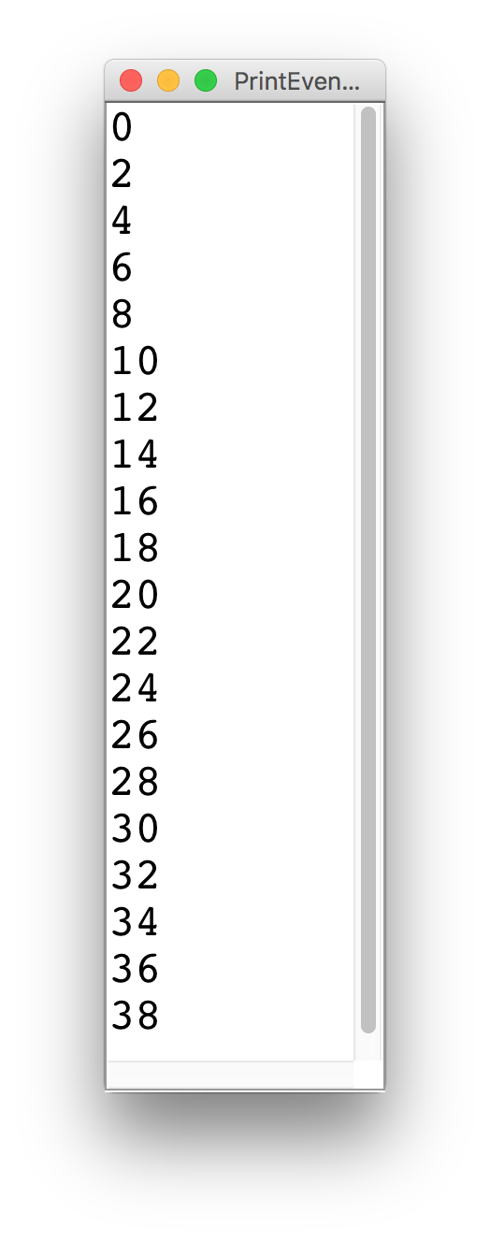
Printing Even Numbers

Slide 33
Printing Even Numbers
for(int i = 0; i < NUM_NUMS; i++) {
println(i * 2);
}

Slide 34
Printing Even Numbers
for(int i = 0; i < 3; i++) {
println(i * 2);
}
For Loop Redux

Slide 35
Printing Even Numbers
for(int i = 0; i < 3; i++) {
println(i * 2);
}
For Loop Redux

Slide 36
Printing Even Numbers
i
0
for(int i = 0; i < 3; i++) {
println(i * 2);
}
For Loop Redux

Slide 37
Printing Even Numbers
i
0
for(int i = 0; i < 3; i++) {
println(i * 2);
}
For Loop Redux

Slide 38
Printing Even Numbers
i
0
for(int i = 0; i < 3; i++) {
println(i * 2);
}
For Loop Redux
0

Slide 39
Printing Even Numbers
i
1
for(int i = 0; i < 3; i++) {
println(i * 2);
}
For Loop Redux
0

Slide 40
Printing Even Numbers
i
1
for(int i = 0; i < 3; i++) {
println(i * 2);
}
For Loop Redux
0

Slide 41
Printing Even Numbers
i
1
for(int i = 0; i < 3; i++) {
println(i * 2);
}
For Loop Redux
0
2

Slide 42
Printing Even Numbers
i
2
for(int i = 0; i < 3; i++) {
println(i * 2);
}
For Loop Redux
0
2

Slide 43
Printing Even Numbers
i
2
for(int i = 0; i < 3; i++) {
println(i * 2);
}
For Loop Redux
0
2

Slide 44
Printing Even Numbers
i
2
for(int i = 0; i < 3; i++) {
println(i * 2);
}
For Loop Redux
0
2
4

Slide 45
Printing Even Numbers
i
3
for(int i = 0; i < 3; i++) {
println(i * 2);
}
For Loop Redux
0
2
4

Slide 46
Printing Even Numbers
i
3
for(int i = 0; i < 3; i++) {
println(i * 2);
}
For Loop Redux
0
2
4

Slide 47
Printing Even Numbers
i
3
for(int i = 0; i < 3; i++) {
println(i * 2);
}
For Loop Redux
0
2
4

Slide 48
Printing Even Numbers
for(int i = 0; i < 3; i++) {
println(i * 2);
}
For Loop Redux
0
2
4

Slide 49
Back to our regularly scheduled program…

Slide 50
Types of Programs
Program
Karel Program
Console Program
Graphics Program

Slide 51
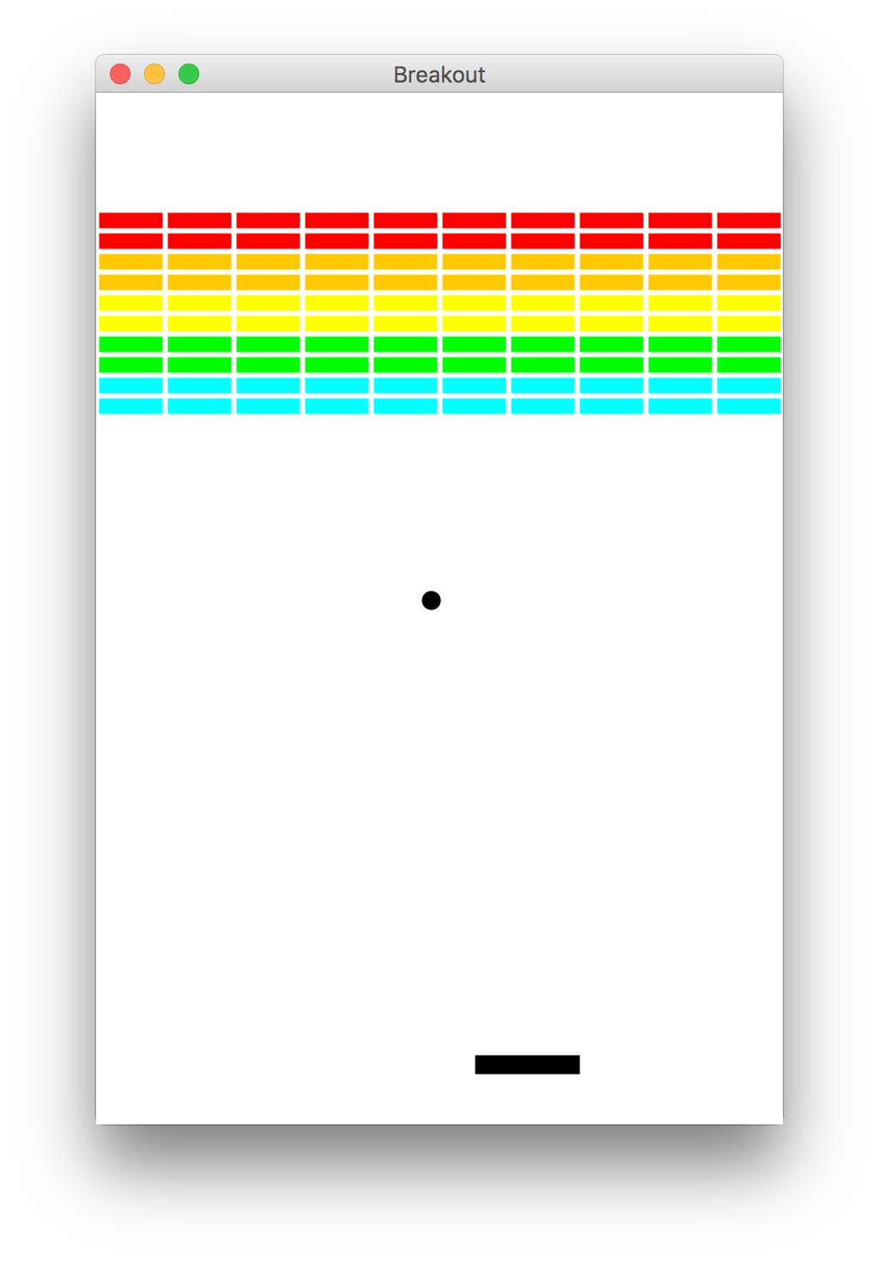
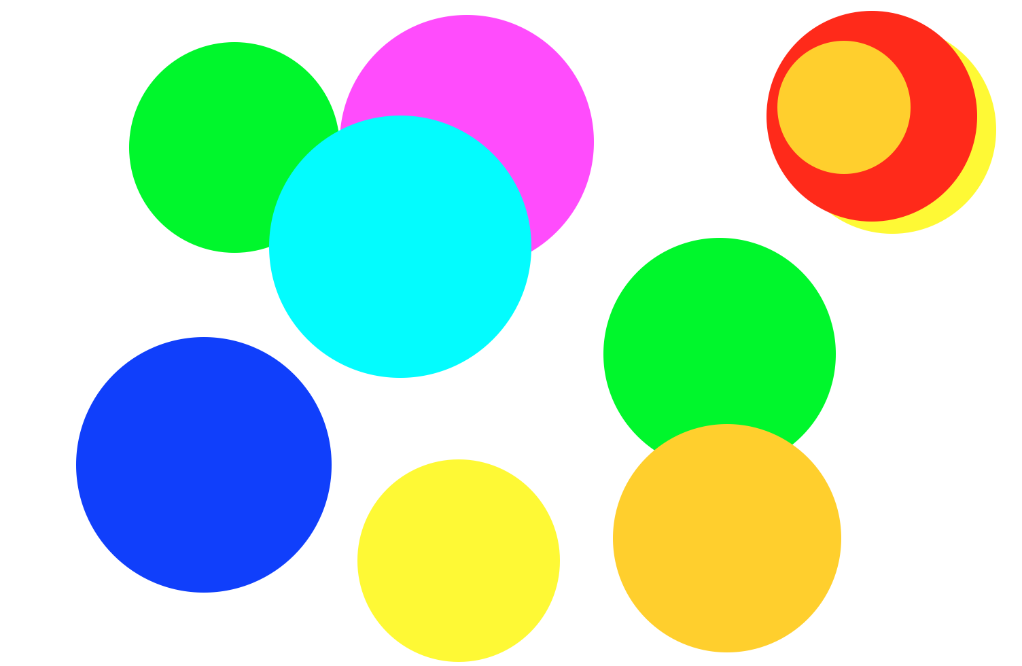
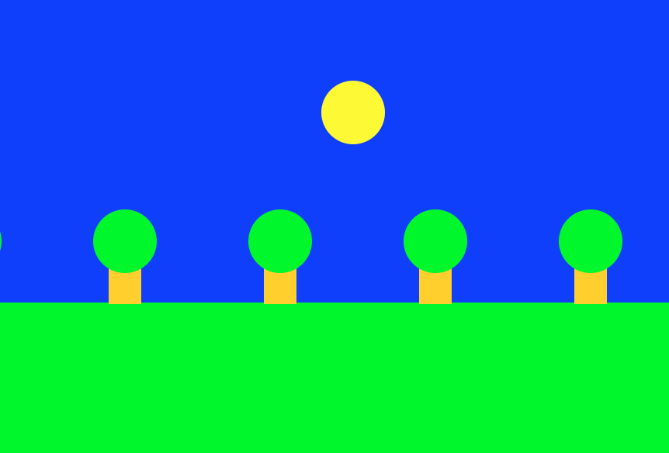
Graphics Programs

Slide 52
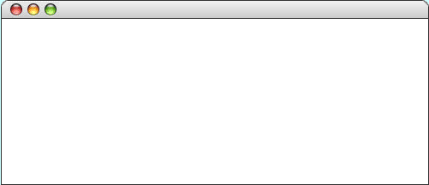
GRect
GRect is a variable type that stores a rectangle.
As an example, the following run method displays a blue square
public void run() {
GRect rect = new GRect(200, 200);
rect.setFilled(true);
rect.setColor(Color.BLUE);
add(rect, 50, 50);
}
Hello Rect
rect

Slide 53
GRect
GRect is a variable type that stores a rectangle.
As an example, the following run method displays a blue square
public void run() {
GRect rect = new GRect(200, 200);
rect.setFilled(true);
rect.setColor(Color.BLUE);
add(rect, 50, 50);
}
Hello Rect
rect

Slide 54
GRect
GRect is a variable type that stores a rectangle.
As an example, the following run method displays a blue square
public void run() {
GRect rect = new GRect(200, 200);
rect.setFilled(true);
rect.setColor(Color.BLUE);
add(rect, 50, 50);
}
Hello Rect
rect

Slide 55
GRect
GRect is a variable type that stores a rectangle.
As an example, the following run method displays a blue square
public void run() {
GRect rect = new GRect(200, 200);
rect.setFilled(true);
rect.setColor(Color.BLUE);
add(rect, 50, 50);
}
Hello Rect
rect

Slide 56
GRect
GRect is a variable type that stores a rectangle.
As an example, the following run method displays a blue square
public void run() {
GRect rect = new GRect(200, 200);
rect.setFilled(true);
rect.setColor(Color.BLUE);
add(rect, 50, 50);
}
Hello Rect
rect

Slide 57
Graphics Coordinates
0,0
40,20
120,40
getHeight();
40,120
getWidth();

Slide 58
Rectangles, Ovals, Text

Slide 59
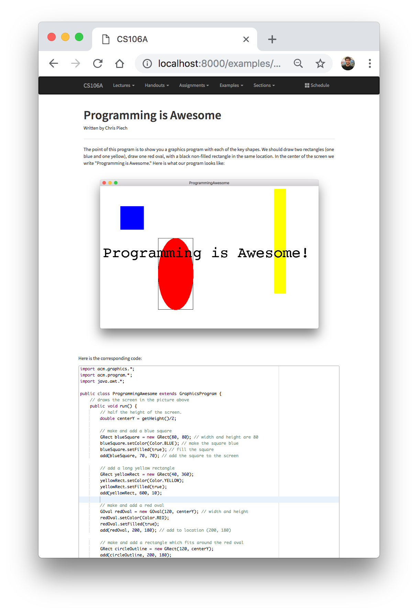
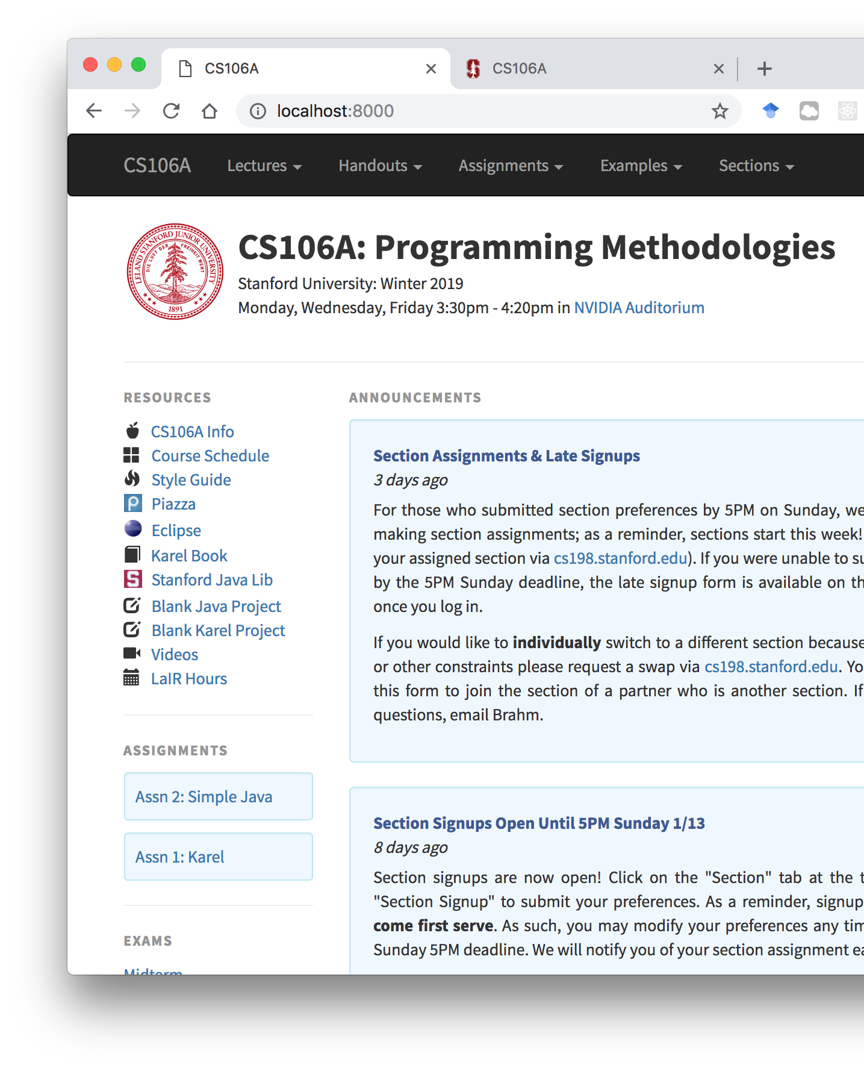
Pedagogy

Slide 60
GRect
GRect is a variable type that stores a rectangle.
As an example, the following run method displays a blue square
public void run() {
GRect rect = new GRect(200, 200);
rect.setFilled(true);
rect.setColor(Color.BLUE);
add(rect, 50, 50);
}
Hello Rect

Slide 61
GRect
GRect is a variable type that stores a rectangle.
As an example, the following run method displays a blue square
public void run() {
GRect rect = new GRect(200, 200);
rect.setFilled(true);
rect.setColor(Color.BLUE);
add(rect, 50, 50);
}
Hello Rect
rect

Slide 62
GRect
GRect is a variable type that stores a rectangle.
As an example, the following run method displays a blue square
public void run() {
GRect rect = new GRect(200, 200);
rect.setFilled(true);
rect.setColor(Color.BLUE);
add(rect, 50, 50);
}
Hello Rect
rect

Slide 63
GRect
GRect is a variable type that stores a rectangle.
As an example, the following run method displays a blue square
public void run() {
GRect rect = new GRect(200, 200);
rect.setFilled(true);
rect.setColor(Color.BLUE);
add(rect, 50, 50);
}
Hello Rect
rect

Slide 64
GRect
GRect is a variable type that stores a rectangle.
As an example, the following run method displays a blue square
public void run() {
GRect rect = new GRect(200, 200);
rect.setFilled(true);
rect.setColor(Color.BLUE);
add(rect, 50, 50);
}
Hello Rect
rect

Slide 65
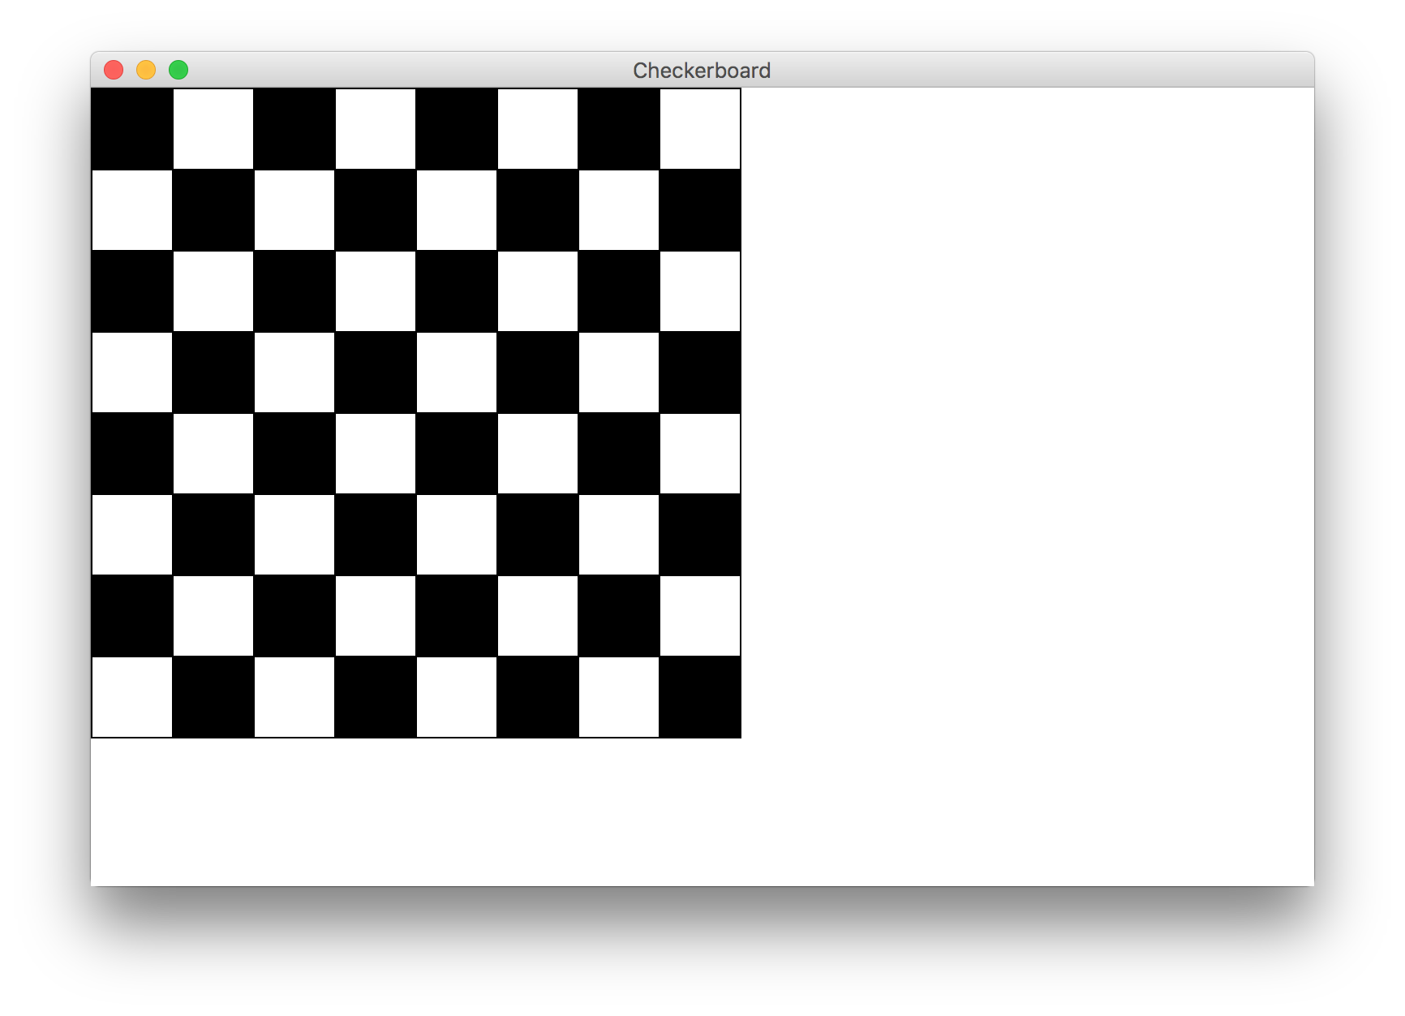
Goal

Slide 66
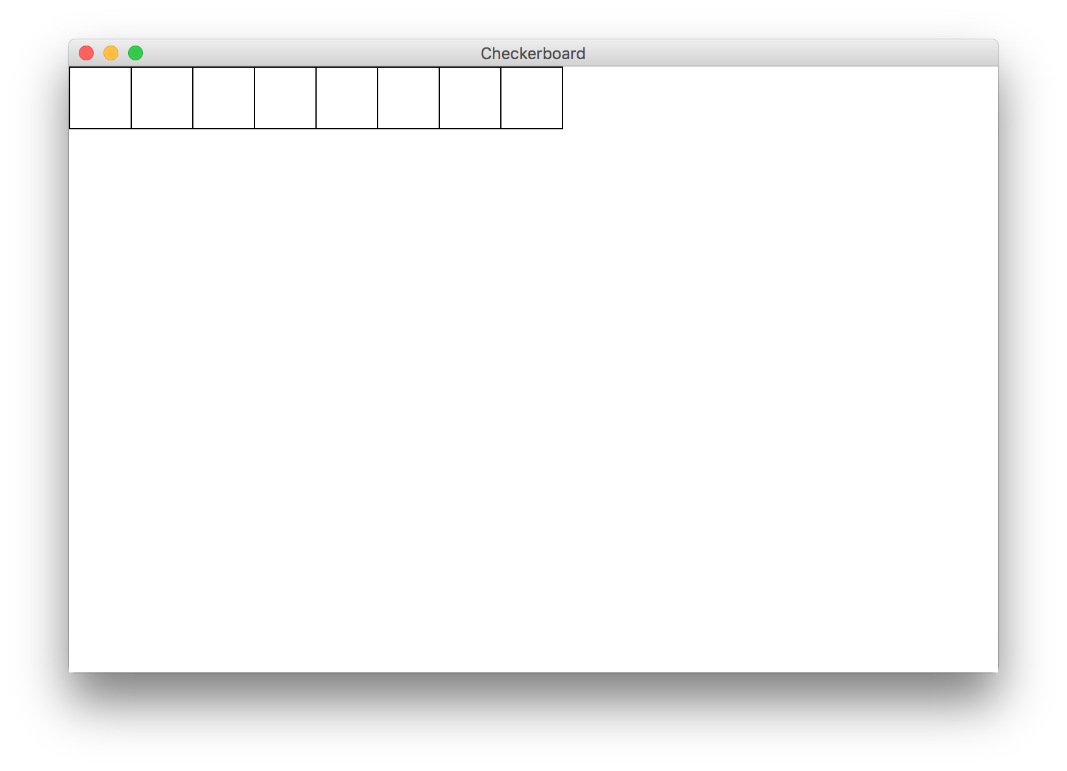
Milestone 1

Slide 67
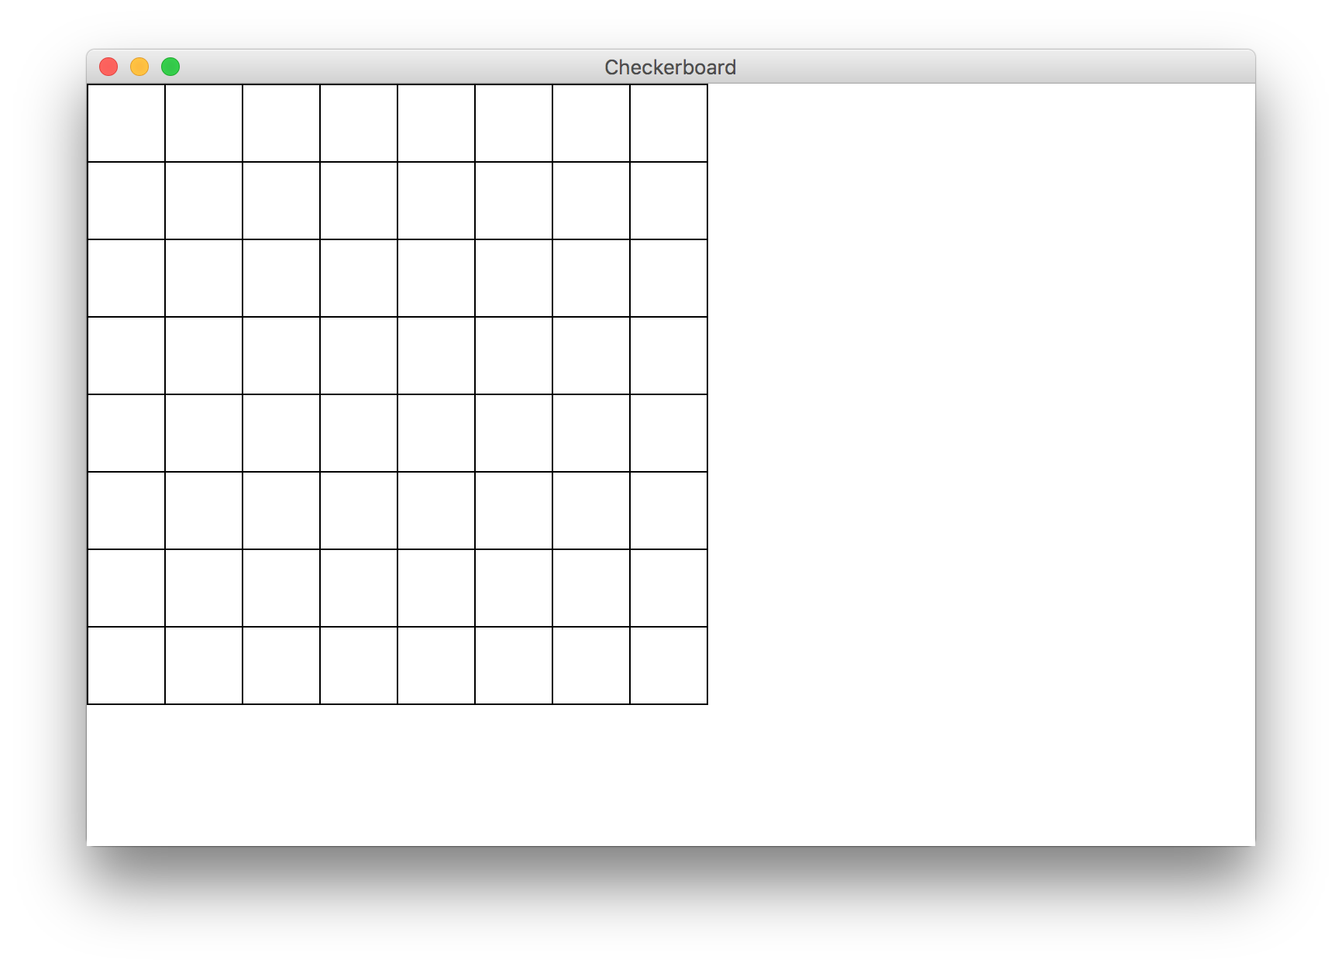
Milestone 2

Slide 68
Milestone 3

Slide 70
Boolean Variables
// Store expressions that evaluate to true/false
boolean x = 1 < 2; // true
boolean y = 5.0 == 4.0; // false
// Directly set to true/false
boolean isFriday = true;
boolean isSunny = false;
// Then you can use the booleans
if (isFriday) {
...
Notes:
Note: does not store the whole expression – just the value.
Note – we don’t need to check if it’s true

Slide 71
Logical Operators
In order of precedence:
Operator | Description | Example | Result
! | not | !(2 == 3) | true
&& | and | (2 == 3) && (-1 < 5) | false
|| | or | (2 == 3) || (-1 < 5) | true
Cannot "chain" tests as in algebra; use && or || instead
// assume x is 15 // correct version
2 <= x <= 10 2 <= x && x <= 10
true <= 10 true && false
Error! false

Slide 72
boolean food = true;
boolean drinks = true;
boolean isAllowed = !food || drinks;
*know your logical precedence

Slide 73
George Boole
English Mathematician 1815 – 1864
Boole died of being too cool

Slide 74
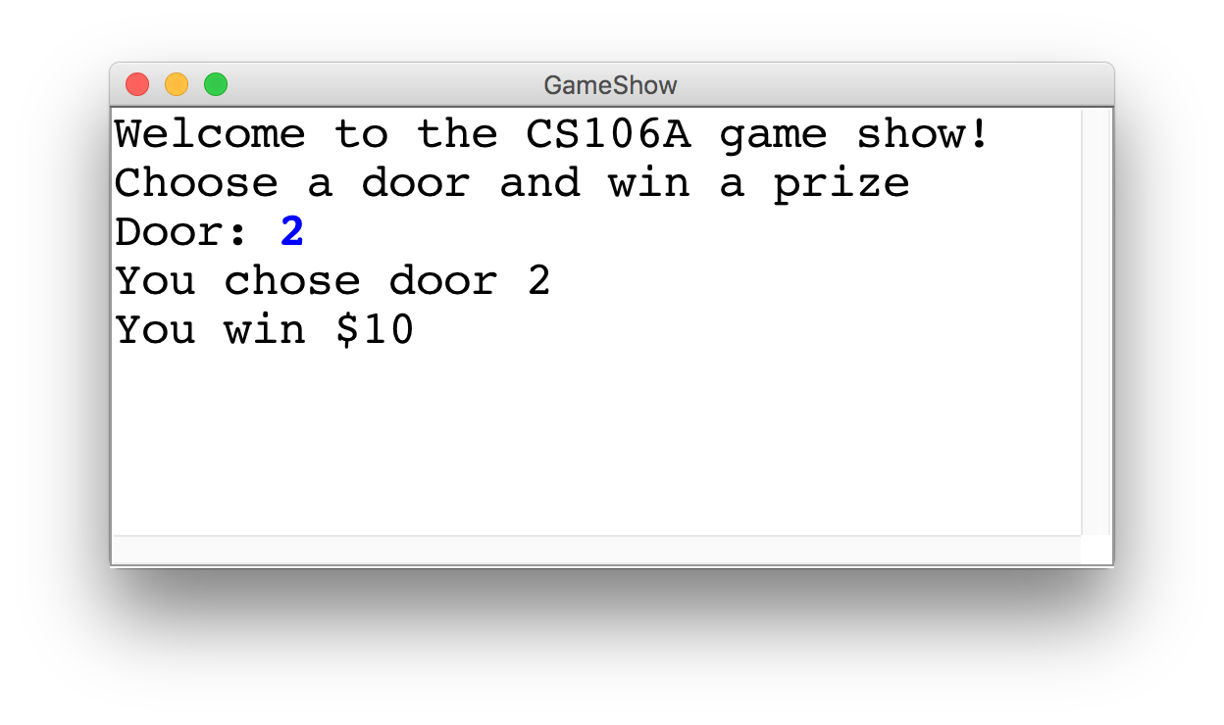
Game Show

Slide 75
Choose a Door
int door = readInt("Door: ");
// while the input is invalid
while(door < 1 || door > 3) {
// tell the user the input was invalid
println("Invalid door!");
// ask for a new input
door = readInt("Door: ");
}
|| or
&& and

Slide 76
The Door Logic
int prize = 4;
if(door == 1) {
prize = 2 + 9 / 10 * 100;
} else if(door == 2) {
boolean locked = prize % 2 != 0;
if(!locked) {
prize += 6;
}
} else if(door == 3) {
prize++;
}

Slide 77
The Door Logic
int prize = 4;
if(door == 1) {
prize = 2 + 9 / 10 * 100;
} else if(door == 2) {
boolean locked = prize % 2 != 0;
if(!locked) {
prize += 6;
}
} else if(door == 3) {
prize++;
}

Slide 78
The Door Logic
int prize = 4;
if(door == 1) {
prize = 2 + 9 / 10 * 100;
} else if(door == 2) {
boolean locked = prize % 2 != 0;
if(!locked) {
prize += 6;
}
} else if(door == 3) {
prize++;
}

Slide 79
The Door Logic
int prize = 4;
if(door == 1) {
prize = 2 + 9 / 10 * 100;
} else if(door == 2) {
boolean locked = prize % 2 != 0;
if(!locked) {
prize += 6;
}
} else if(door == 3) {
prize++;
}

Slide 80
The Door Logic
int prize = 4;
if(door == 1) {
prize = 2 + 9 / 10 * 100;
} else if(door == 2) {
boolean locked = prize % 2 != 0;
if(!locked) {
prize += 6;
}
} else if(door == 3) {
prize++;
}

